Slide 1
vim
a beginner’s journey to coding awesomely:w

Slide 2
who am i?
kyle tolle
ambitious software developer
@kyletolle
https://github.com/kyletolle
Notes:
Add nullsix link?
This is my first talk, so any feedback is welcome! Follow me on twitter. My github has this presentation as well as my .vimrc, which you might like to check out.

Slide 3
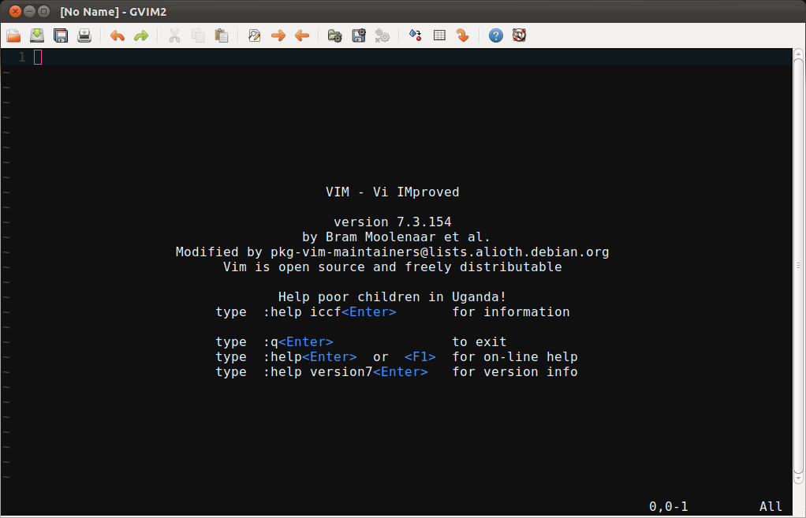
vim

Slide 4
what is vim?
highly configurable text editor
improved version of the vi editor
perfect for lazy devs
muscle memory maker
Notes:
Vi should come installed by default on most distros
Vim gets out of your way and aims to be an invisible, but powerful, tool.
Good devs are lazy. They don’t like to do the same thing twice. Vim embraces that mindset.
It might not make sense at first, but when you get used to the keystrokes, you won’t even think about it. Just like breathing!

Slide 5
what isn’t vim?
not a word processor
not a hand holder
not a tool learned in a week
never gonna let you down
Notes:
Not here for rich text or WYSIWYG editing.
Doesn’t hold your hand, but there are so many learning resources you shouldn’t be discouraged!
The sheer enormity and power of this tool means you’ll still learn new things, no matter how much you already know.
The documentation and community for vim are fantastic. If you want to do something, there’s a good chance someone else has. Or you can find out how to do it pretty quickly.

Slide 6
begin
install
run vim or gvim
learn, learn, learn
vimtutor (from the cli)
:help user-manual or :help quickref
tweak
Notes:
There are versions of vim to run on pretty much everything.
vim opens up in the terminal. Gvim is a GUI-fied version that opens in a new window.
The documentation is comprehensive. Start with vimtutor, then move to :help. Probably helps to print off a cheatsheet too.
Once you start using it, you’ll get an idea of things you’d like to customize or simplify. You can tweak vim easily.

Slide 7
1st things 1st
what are some common things you do while editing text, code, config files, etc?
open vimtutor or a file to learn by doing!
Notes:
Move around, edit, undo, refactoring, indenting, autocomplete, search and replace, refactoring, indenting, autocomplete, diffing.
Syntax highlighting, folding code, macros, key mappings, color schemes – all nice pluses.
Please open up a file or some code that you can edit. The best way to learn vim is by doing!

Slide 8
normal mode
you’re in normal mode by default
move around and perform commands
not for typing text
<ESC> gets you back to normal mode from any other mode
Ctrl-[ is equivalent, less hand movement
Notes:
Explain that ESC was chosen when that key used to be where tab is now places on the keyboard.
In order to keep from moving your hand all the way there, you can also use Ctrl-[ to do same thing

Slide 9
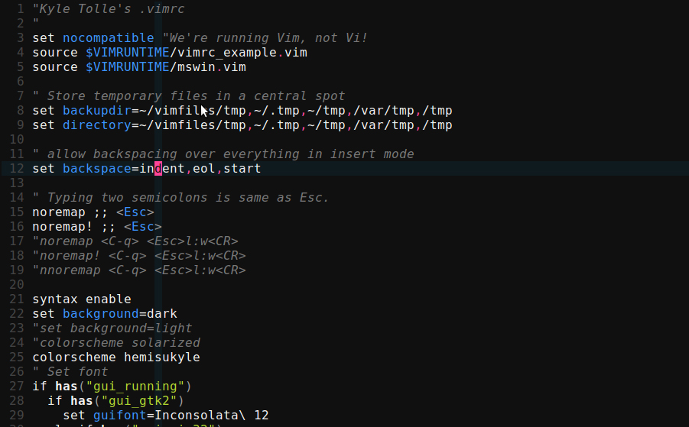
normal cursor

Slide 10
move around
^
k
< h
l >
j
v
Notes:
The whole point is to keep your hands on the home row, ready to go.
h moves you left a character, j down a line, k up a line, l right a character

Slide 11
what?
vim is a muscle memory
can use arrow keys but i’m lazy
trust in the vim - it’ll be faster

Slide 12
insert mode
i - insert before cursor
type in whatever you’d like
<ESC> to get back to normal mode
get used to hitting <ESC> after editing text
you’ll always end in normal mode
Notes:
Insert mode is where you can actually type or delete text as you would in other text editors.
Always hit <ESC> to get back to normal mode. It’ll become habit after a while. If you sit there thinking for a while, you’ll know you’re in normal mode. If you take a break or switch windows, when you come back, you’ll always be in normal mode.
Otherwise you’ll have something like :w or dd randomly in your file.

Slide 13
insert mode
i - insert before cursor
a – insert after cursor
I – insert at start of line
A – append to end of line
Notes:
Think i for insert, a for append. Notice the shifted letters operate on the line as a whole?
It really helps to start using it and getting used to hitting the keys. It doesn’t make a lot of sense for me to just sit here and tell you, but if you see and then do, it’ll stick better.

Slide 14
see the pattern?
a letter does something
shift modifies it in some way
ctrl also modifies some keys
vim is full of patterns
Notes:
Notice this patter of the lowercase letter doing something. If you hit shift and that letter, it does something different, and, though we haven’t seen it, ctrl and that latter usually does something different again.
type :help i or :help I to see what that key does. This is incredibly helpful! Very awesome.
But now that you’ve done that, it actually opened up another buffer. Now, let’s see what that’s about.

Slide 15
un-pattern
H,J,K,L are oddities
J joins lines, which is handy
use :help for others
Notes:
Notice this patter of the lowercase letter doing something. If you hit shift and that letter, it does something different, and, though we haven’t seen it, ctrl and that latter usually does something different again.
type :help i or :help I to see what that key does. This is incredibly helpful! Very awesome.
But now that you’ve done that, it actually opened up another buffer. Now, let’s see what that’s about.

Slide 16
help is helpful
type one of the following
:help i
:help I
use :help to figure out things do
tab completion works here!
Ctrl-d is another way to show completion options

Slide 17
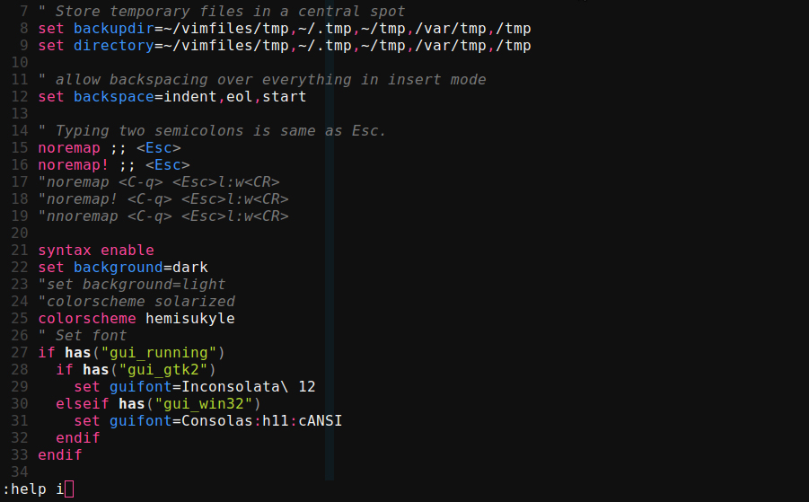
typing command

Slide 18
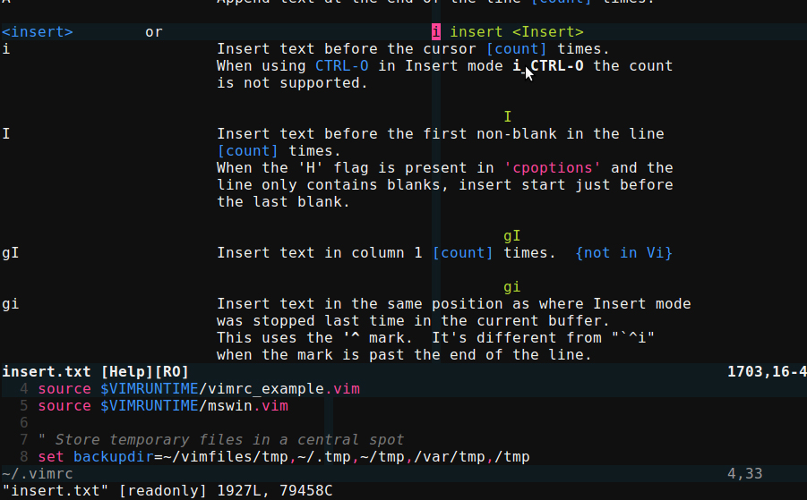
help split

Slide 19
help split
the :help command split the window
we’ll learn more about this later
for now, know that :q closes it

Slide 20
editing
x – delete char under cursor
r{char} – replace char under cursor with {char}
R – replace multiple characters, starting with char under cursor
. – repeat last command

Slide 21
writing file
we made some changes we want to save
:w writes the file
if not in normal mode, :w’s may appear in your file!

Slide 22
commands
from normal mode, type :
:w - write
:q - quit
:e – edit (without arguments reloads current file)
append a ! to force the command
:wq is common
:help :e
Notes:
Writing the file, quitting, reloading, etc. Appending a bang forces the command. For instance :q to quit an edited file will give you a message. :q! quits without that message and without writing. You can string them together: :wq to write and quit the file.

Slide 23
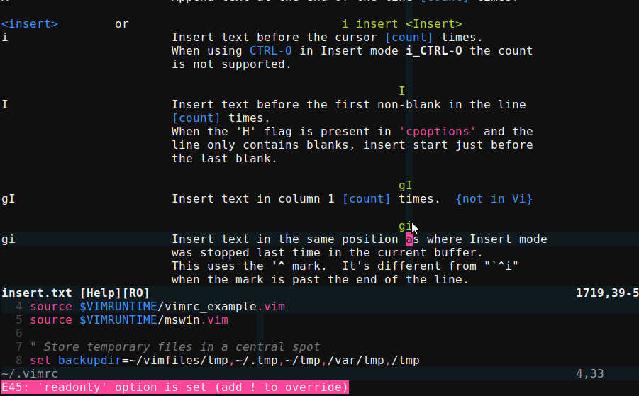
readonly msg

Slide 24
motions
move around the file with certain motion keys
w – start of next word
e – end of this word
b – back a word
use help to find out what W,E,B do

Slide 25
more motions
^ - start of text on this line
$ - end of this line
0 – very beginning of this line
Notes:
^ and $ are like regexes.

Slide 26
more motions
gg – beginning of file
G – end of file
h,j,k,l are movements too

Slide 27
bigger picture
pair motions with commands
general formula is
{#}command{motion}
perform the command this many times
what command to perform
what motion to perform the command over

Slide 28
commands
manipulate text from normal mode
{#}d{motion} – delete
{#}c{motion} – change
. repeats the last command
feels good to be lazy!
Notes:
Mention some of the most common: dw, cw

Slide 29
linewise commands
work on whole line
dd - delete
cc - change
yy - yank
>> - indent
<< - de-indent

Slide 30
oops
u – undo
U – undo all changes made to this line
Ctrl-r – redo
Notes:
vi could only remember one undo

Slide 31
copy/paste
{#}y{motion} – yank
p – paste after cursor
P – paste before cursor

Slide 32
new lines
o – insert new line below current
O – insert new line above current
puts you in insert mode as well

Slide 33
a word, inner word
eg. you’re at the end of the word, but want to delete the whole word without moving cursor back
daw – delete a word - also deletes whitespace following word
diw – delete inner word - only deletes text; leaves whitespace
:help aw or :help iw
Notes:
can use with change, yank, etc.

Slide 34
power
there are a ton of possibilities
3dk – delete 3 lines up
5,10y – yank lines 5 through 10
try chaining commands
Notes:
Mention some of the most common: dw, cw

Slide 35
autocomplete
in insert mode, type first part of word, then press
Ctrl-n - insert next matching word
Ctrl-p – insert previous matching word
repeat to cycle through matches
:help i_ctrl-n

Slide 36
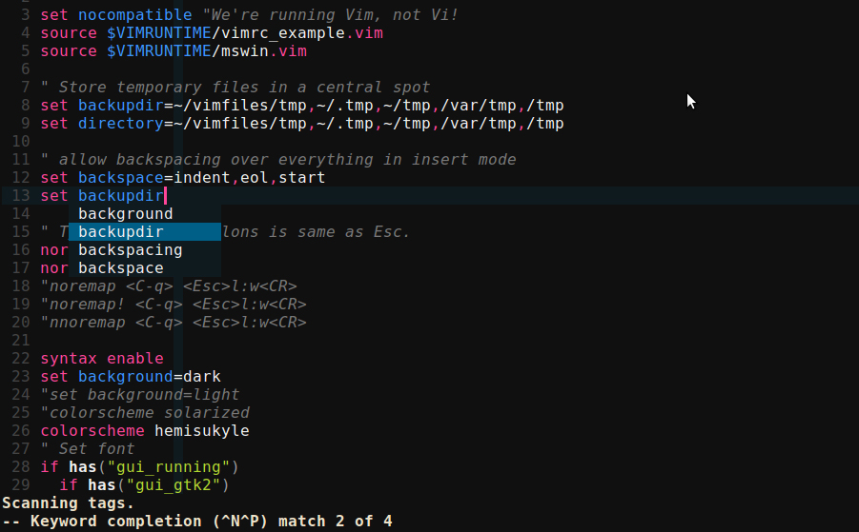
autocomplete

Slide 37
jumping around
Ctrl-f – jump forward a screen
Ctrl-b – jump backward a screen
:{#} - to go to line #
Ctrl-o – follow breadcrumb backward
Ctrl-i – follow breadcrumb forward

Slide 38
searching
/{text} - search forward
?{text} – search backward
n – repeat search in that direction
N – repeat search in opposite direction

Slide 39
searching
Searches wrap around file start/end
* - search forward for word under cursor
# - like * but backward
n and N work for repeating

Slide 40
improving search
:set ignorecase – case insensitive
:set smartcase – ignore case only if all lowercase
:set incsearch – shows first matching word as you type
add these lines (without semicolons) to .vimrc to have them be defaults

Slide 41
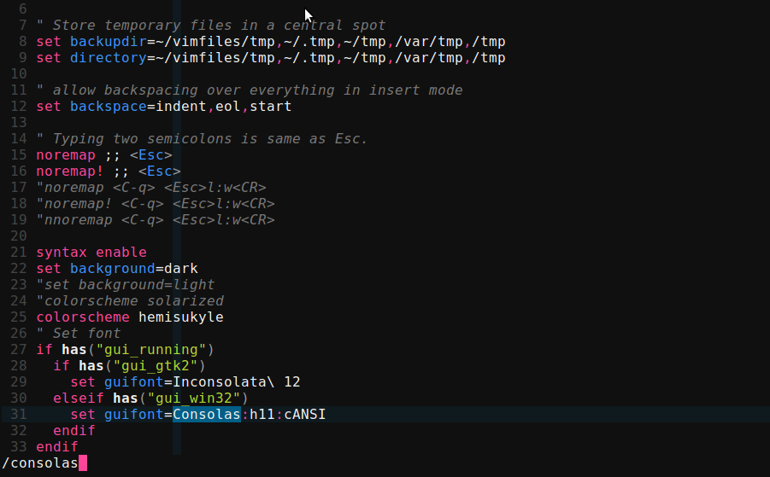
incsearch

Slide 42
search highlight
:set hlsearch – highlights search term througout the file
:noh – no highlight – clears highlights if you no longer want them displayed

Slide 43
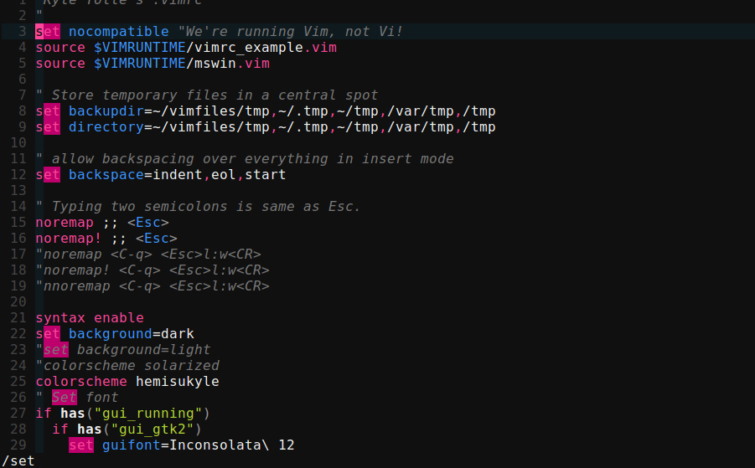
hlsearch

Slide 44
substitution
:s/old/new – replace first occurrence of old with new on this line
add flags to the end:
:s/old/new/gc
g – global - replaces all occurrences on line
c – confirmation - prompts confirmation each time

Slide 45
substitution
:%s/old/new/g – replace all occurrences of old with new in whole file
:%s/old/new/ - replace first occurrence of old with new on all lines in whole file
& - repeat last substitution

Slide 46
buffers
each file opened is its own buffer
might only be viewing one buffer but the others are still open
switch between buffers
show buffers in different windows

Slide 47
buffers
:e {filename} – edit filename in current window - creates new buffer
:ls – show buffers
:b{#} - switch to buffer #
:bn,:bp – buffer next/previous
:bd – buffer delete

Slide 48
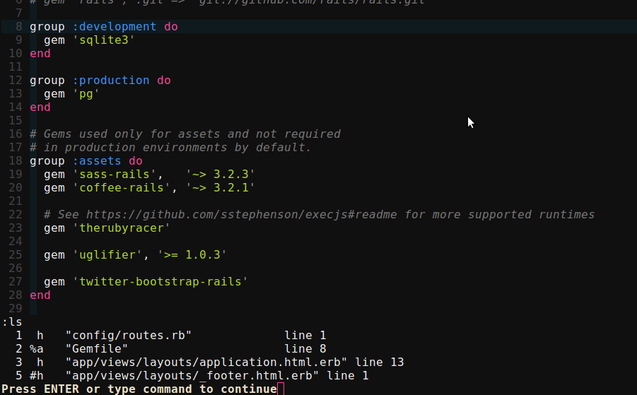
:ls

Slide 49
buffer/file info
Ctrl-g or :f shows
current file name
cursor position
file status (read-only, modified, etc)
helpful to get bearings when switching between buffers

Slide 50
windows
:help {foo} splits the window
show multiple buffers at same time
eg. edit spec/code side by side

Slide 51
splitting windows
can split the edit area multiple ways
:sp(lit) - horizontal
:vs(plit) – vertical
:q closes current window
buffer still exists

Slide 52
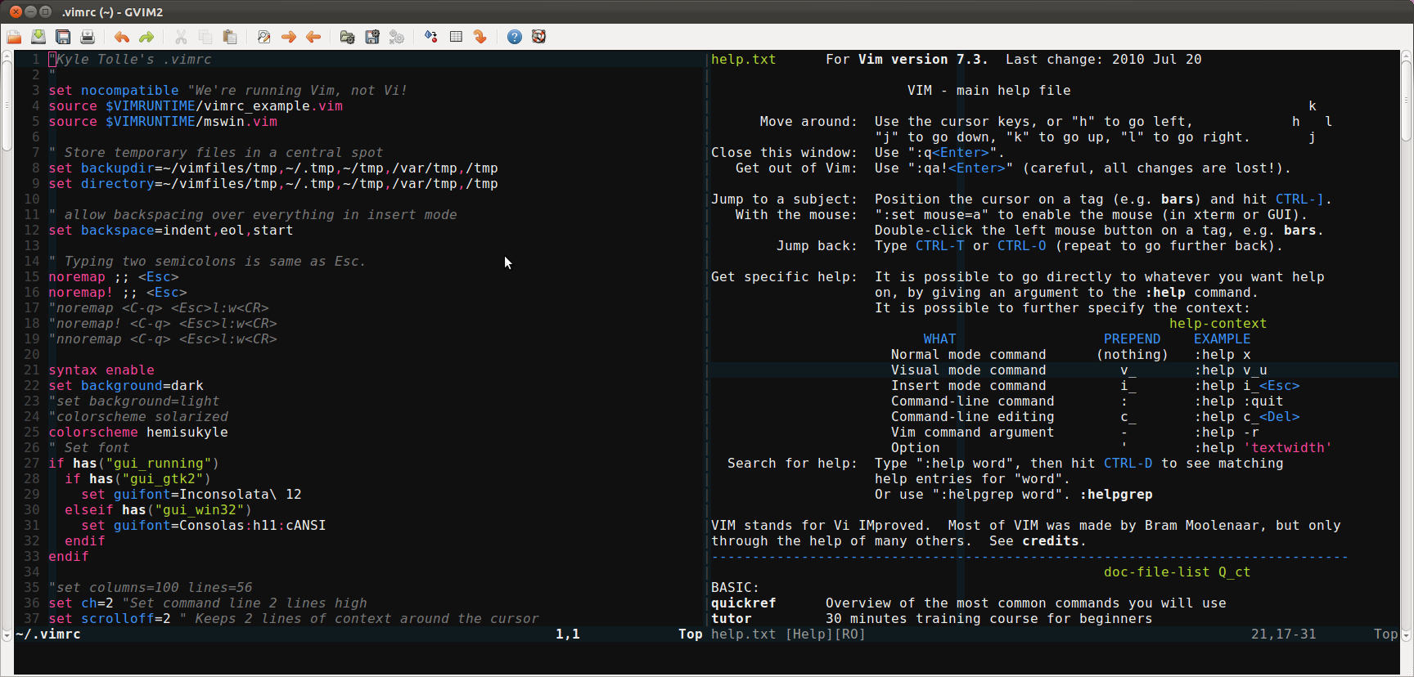
vsplit

Slide 53
window commands
Ctrl-w w - cycles between windows
Ctrl-w h,j,k,l - moves to window in that direction
:help Ctrl-w for more commands

Slide 54
visual mode
one of many modes
starts a highlighted area
v – visual mode per character
V – visual mode linewise
Ctrl-v – visual mode blockwise

Slide 55
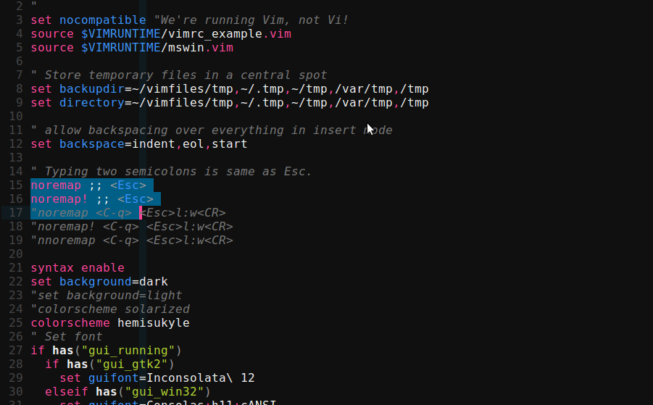
visual mode

Slide 56
visual mode
once visual mode is selected, use motions to expand the highlighted text
V j – selects this line and 1 below
after selected, use a command
delete/yank/substitute/etc
performed only to the selected area

Slide 57
.vimrc
file containing vim customizations
see my .vimrc in my dotfiles repo
https://github.com/kyletolle/dotfiles
other people share their vimrcs
mix and match as you choose

Slide 58
create .vimrc
:e ~/.vimrc – unix
:e $VIM/_vimrc – windows
:r $VIMRUNTIME/vimrc_example.vim
:w to write the file
:help vimrc-intro

Slide 59
colorschemes
many come with vim
solarized is a popular one
color packs you can download
make your own!

Slide 60
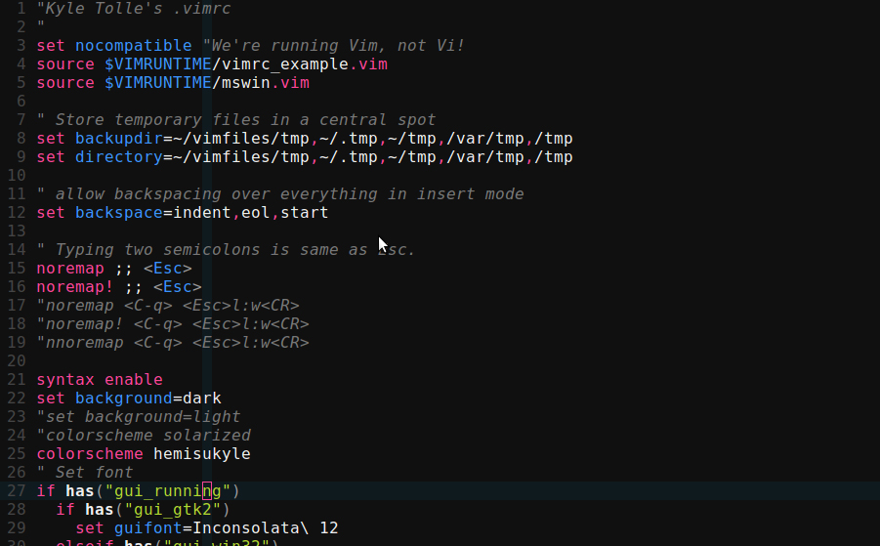
mine

Slide 61
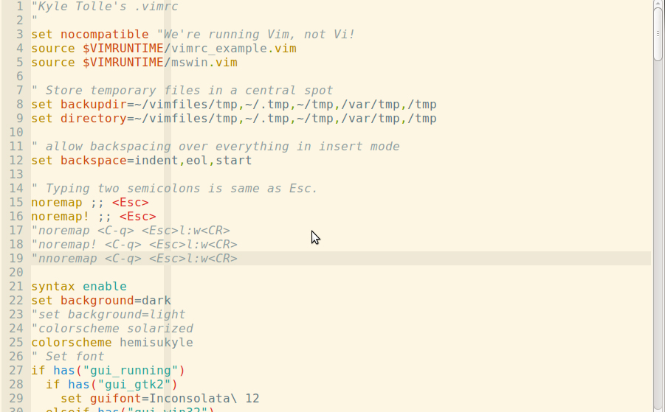
solarized

Slide 62
more motions
f{char} – moves cursor forward (right) to first occurrence of char
F{char} – like f, but to the left

Slide 63
more motions
t{char} – moves cursor forward just before first occurrence of char
T{char} – like t, but to the left
; - repeat latest f,F,t,T
, - repeat latest f,F,t,T in opposite direction

Slide 64
advanced
filetypes
language support
syntax highlighting
other modes

Slide 65
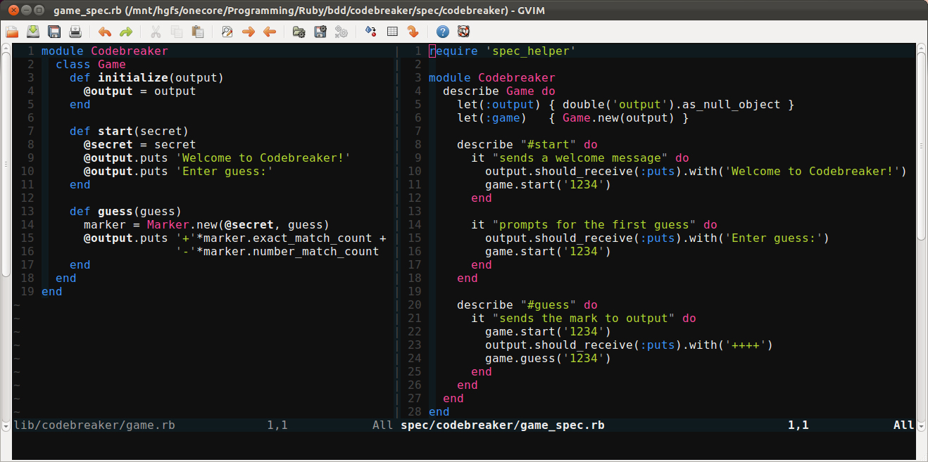
ruby

Slide 66
advanced
gvimdiff file1 file2
commands related to diffing/merging files
folds
collapse blocks of code
marks – jump around file easier
ma – mark the current like as a
‘a – jump to mark a
Ctrl-o, Ctrl-i – jump backward and forward to last places you were

Slide 67
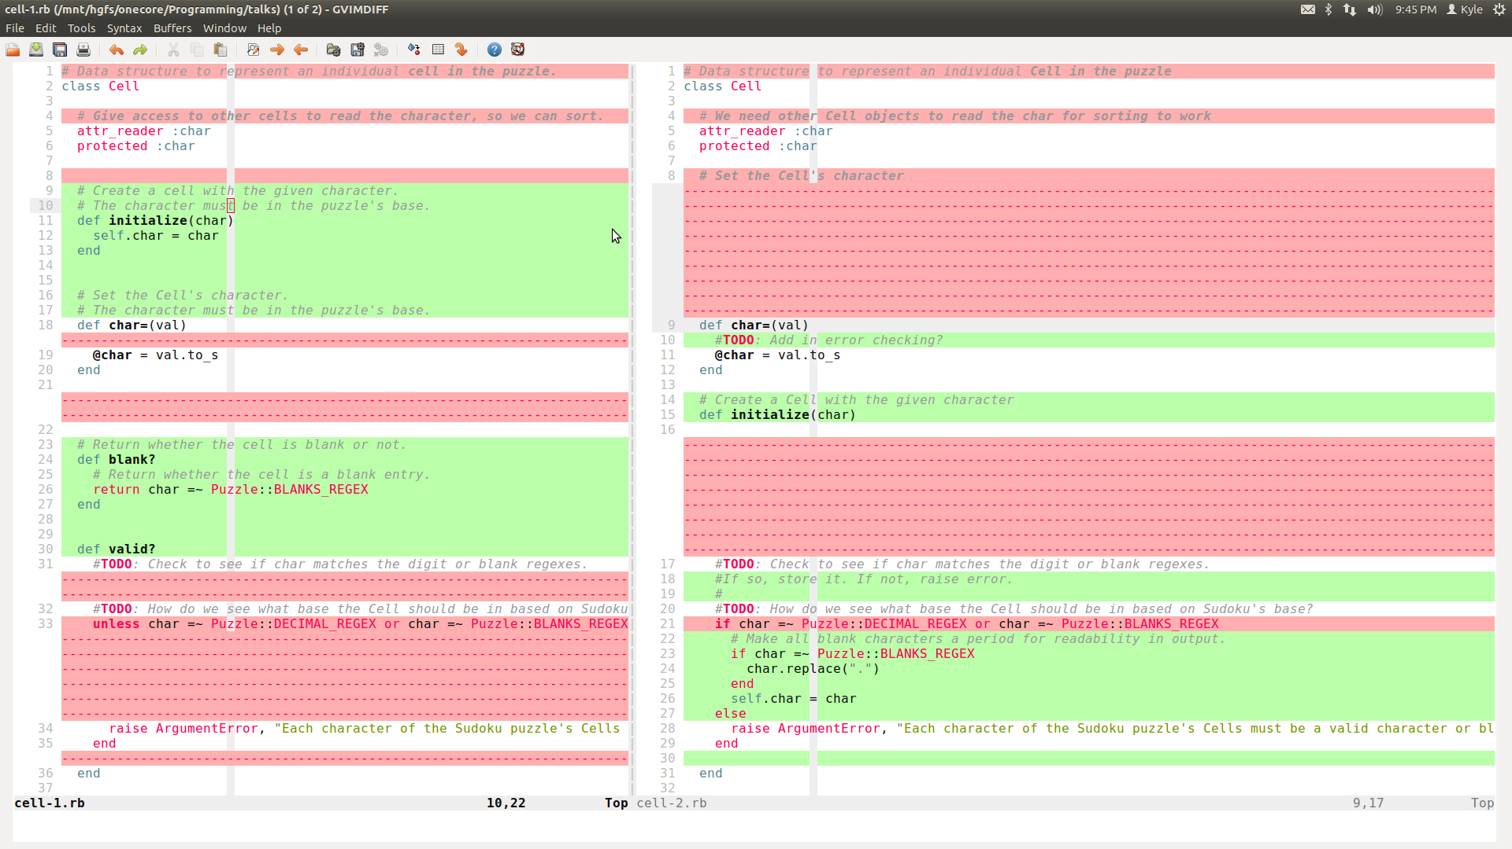
gvimdiff

Slide 68
advanced
. – refers to current line
% - refers to current file
ranges for commands
examples:
:> - indent this line
:.> - indent this line
:.,+2> – indent this and the next two lines
:.,’a>> - indent two times from this line until mark a
:%>> indent this whole file two times

Slide 69
advanced
macros
repeat a series of actions that you record
key mapping
customize things as you like
plugins
Command-T for fuzzy file finding

Slide 70
advanced
registers
deleting or yanking puts content into default registers
can specify other registers though
tabs
different view/window layout of the open buffers
matching
% - match current punctuation
see if {}, (), do/end, etc. match up properly

Slide 71
references
http://www.vim.org
http://vim.wikia.com
get a copy of this talk
https://github.com/kyletolle/talks
cheatsheet
http://simpletutorials.com/tutorials/vim/vimquick.pdf

Slide 72
questions?
thanks for showing up!
i appreciate any and all feedback!
improve your vimfoo!

